Slide 1
Novel Protein design
BTY516: protein engineering

Slide 2
Question
Why design novel proteins?
what can be gained by the design and characterization of novel proteins?
Can we design 3D protein structures that have never been observed?
Are the 3D structures that have not been observed in nature unattainable, or just unsampled?

Slide 3
Main Motivations
our understanding of natural proteins--their folding pathways, thermodynamic stabilities, and catalytic properties -- is enhanced (and ultimately tested) by our ability to design novel proteins with predetermined structures and properties.
For solving important chemical or biochemical problems.

Slide 4
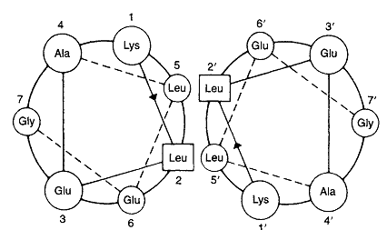
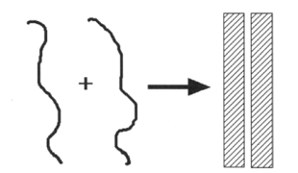
STRATEGIES FOR THE DESIGN OF STRUCTURE
Self-Assembly of Modular Units of Secondary Structure
Schematic diagram showing the self-assembly of two peptides into an ordered dimeric structure.
End-on view of two parallel (α-helices forming a coiled-coil structure. A single heptad repeat is shown and the view is looking from the N-terminal end with the a-helices descending into the page.

Slide 5
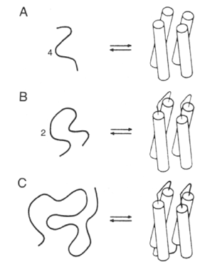
STRATEGIES FOR THE DESIGN OF STRUCTURE
Schematic illustration of the incremental approach

Slide 6
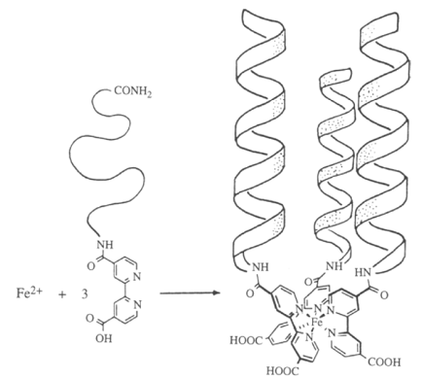
STRATEGIES FOR THE DESIGN OF STRUCTURE
2- Ligand-lnduced Assembly
Ligand-induced assembly of a three-helix bundle.

Slide 7
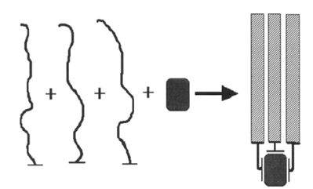
STRATEGIES FOR THE DESIGN OF STRUCTURE
2- Ligand-lnduced Assembly
Schematic diagram showing ligand-induced assembly.

Slide 8
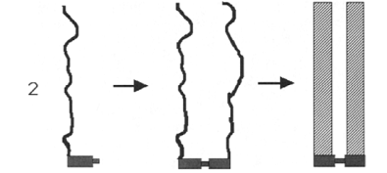
STRATEGIES FOR THE DESIGN OF STRUCTURE
3- Assembly of Peptides via Covalent Cross-linking
Schematic diagram showing the assembly of a structure that is stabilized by
covalent cross-link

Slide 9
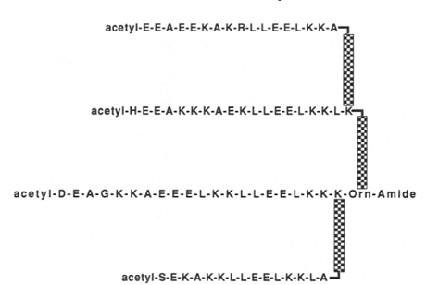
STRATEGIES FOR THE DESIGN OF STRUCTURE
The amino acid sequence and cross-linking pattern of Chymohelizyme

Slide 10
STRATEGIES FOR THE DESIGN OF STRUCTURE
4- Assembly of Peptides on a Synthetic Template
Schematic diagram of a template-assembled synthetic protein (TASP).

Slide 11
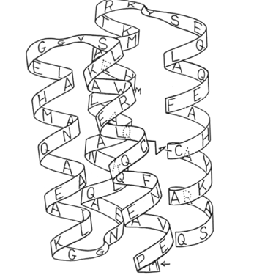
STRATEGIES FOR THE DESIGN OF STRUCTURE
5-Linear Polypeptides That Fold into Globular Structures
Ribbon drawing of the sequence and proposed structure of Felix. The
Cysll-Cys71 disulfide bond is indicated

Slide 12
Reference
Carey, P.R. (1996). Protein Engineering and Design. Academic Press.

